Slide 1
Cross-border enforcement defense Issues
Allen & Overy LLP

Slide 2
Agenda for today
Current enforcement environment and relevance of cross border aspects
Handing requests for information held outside the U.S.
Key foreign legal considerations: data privacy and bank secrecy
Key foreign legal considerations: privilege
Key strategic and tactical issues
Managing an MLAT process with U.S. authorities
Handling requests for testimony of employees outside the U.S.
Key practical takeaways

Slide 3
Current enforcement environment and relevance of cross border aspects
Given the global nature of most of the commodity markets, the CFTC has its tentacles in multiple jurisdictions
The exchanges are providing opportunities for trading more foreign related markets
Cryptocurrency will naturally cross borders

Slide 4
Handling requests for information held outside the U.S.
Initial factors to consider:
Purpose and nature of request
Recipient of request – U.S. entity or foreign affiliate?
Nature and structure of relevant trading and other relationships
Location of responsive information
Ownership and control of responsive information
Foreign legal limitations on production
Strategic and tactical issues

Slide 5
Key foreign legal considerations: data privacy and bank secrecy
Position in Europe
GDPR
Bank secrecy
Blocking statutes
Position in APAC
Hong Kong
Data protection
Bank secrecy
Other jurisdictions
Singapore bank secrecy
Chinese state secrecy

Slide 6
Key strategic and tactical issues
Pros and cons of involving local regulators
Approach to dealing with requests from U.S. authorities
Levels of cooperation with U.S. authorities
Risk of parallel investigations
Might U.S. cooperation credit be put at risk?

Slide 7
Managing a MLAT process with U.S. authorities
Negotiating scope of information request(s)
Time delays
Cooperation issues

Slide 8
Handling requests for testimony of employees outside the U.S.
Testimony of non-US persons
Voluntarily v. compulsory process
Medium (phone v. in person, in US v. via overseas regulator)
Consent to U.S. jurisdiction by: exchange membership or designation as a principal or associated person of NFA
Prospect of U.S. criminal liability for non-U.S. persons
Limits (?) of US regulators’ jurisdiction
Potential protections from U.S. liability [Queen for a day etc?]
Extradition risk to the US (e.g. Sarao/HSBC FX traders) c.f. extradition risk from the US [NB – no need to amend the slides for HK I think but interesting to note that reportedly there was a recent request for extradition to the US in respect of a Macanese national resident in HK which was denied following intervention by the PRC – I will try dig out more]

Slide 9
Key practical takeaways
Multiple issues must be considered
Requires expertise in various jurisdictions
Expectations

Slide 10
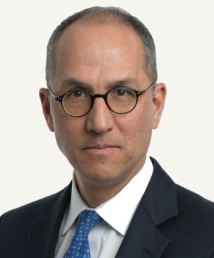
Please don’t hesitate to contact any of us if you have questions:
Gregory Mocek | Partner
USA – Washington
Tel +1 202 683 3887
Mob +1 202 550 6906
gregory.mocek@allenovery.com
Anthony Mansfield | Partner
USA – Washington
Tel +1 202 683 3884
Mob +1 917 609 6422
anthony.mansfield@allenovery.com
Calum Burnett | Partner
UK – London
Tel +44 20 3088 3736
Mob +44 7767 674205
calum.burnett@allenovery.com
Eugene Ingoglia | Partner
USA – New York
Tel +1 212 610 6369
Mob +1 347 598 2690
eugene.ingoglia@allenovery.com
Matt Bower | Partner
Hong Kong
Tel +852 2974 7131
Mob +852 9664 1223
matt.bower@allenovery.com

Slide 11
Thank you very much

